Slide 1
IMDB MOVIE Reviews- Sentiment Analysis
CAPSTONE PROJECT
Presented By:
Ardra Nair,
Lovely Professional University

Slide 2
OUTLINE
Problem Statement
Proposed System/Solution
System Development Approach
Algorithm & Deployment
Result
Conclusion
Future Scope
References

Slide 3
Problem Statement
Example: Given a dataset of 50,000 movie reviews from IMDb, each labeled with either a positive or negative sentiment, the task is to develop a machine learning model capable of accurately predicting the sentiment of a review based on its textual content. This entails building and evaluating several machine learning algorithms to determine which one yields the highest performance in classifying sentiment. The ultimate objective is to deploy a robust sentiment analysis model that can effectively discern the sentiment polarity of movie reviews, aiding in tasks such as recommendation systems, opinion mining, and sentiment analysis of user-generated content.

Slide 4
Proposed Solution
Problem Statement:
The proposed system aims to address the challenge of accurately predicting sentiment polarity (positive or negative) of movie reviews using data analytics and machine learning techniques. This involves leveraging historical data from IMDb, where each review is labeled with its sentiment, to develop a predictive model that can classify reviews into positive or negative categories. Components:
Data Collection:
Gather IMDb dataset comprising movie reviews along with their associated sentiments (positive or negative).
Data Preprocessing:
Clean and preprocess the collected data to handle any inconsistencies, including removing HTML tags, punctuation, and special characters.
Conduct text normalization techniques like tokenization, stemming, and lemmatization to standardize the text data.
Perform feature extraction to convert text data into numerical representations suitable for machine learning algorithms, such as TF-IDF (Term Frequency-Inverse Document Frequency) or word embeddings.
Machine Learning Algorithm:
Implement a machine learning algorithm, such as logistic regression, to train a predictive model on the preprocessed IMDb dataset.

Slide 5
Proposed solution Contd. -
Evaluation:
Assess the model's performance using evaluation metrics like accuracy, Analyze the confusion matrix to understand the model's ability to correctly classify positive and negative sentiments.
Results:
The logistic regression model achieved an accuracy of 89% in classifying movie reviews into positive or negative sentiments.
Overall, the proposed system provides a robust framework for sentiment analysis on IMDb movie reviews, enabling users to gain insights into audience perceptions and preferences.

Slide 6
System Approach
System Approach:
System Requirements:
Historical IMDb dataset containing movie reviews and corresponding sentiment labels.
Python environment with necessary libraries for data manipulation, preprocessing, model building, and evaluation.
Sufficient computational resources for training machine learning models and deploying the solution.
Libraries Required to Build the Model:
scikit-learn (sklearn): Utilized for implementing machine learning algorithms such as logistic regression, data preprocessing, and model evaluation.
pandas: Used for data manipulation and handling the IMDb dataset, including loading data, cleaning, and organizing it for analysis.
NumPy: Essential for numerical computations and operations on arrays, required for various data preprocessing tasks and mathematical operations within the models.
matplotlib and seaborn: Used for data visualization, including plotting histograms, scatter plots, and other visualizations for exploratory data analysis.
neattext: Potentially used for text preprocessing tasks like removing HTML tags, punctuation, or stop words, enhancing the quality of the text data for sentiment analysis.

Slide 7
Algorithm & Deployment
Algorithm Selection:
Logistic Regression is chosen as the machine learning algorithm for sentiment analysis on the IMDb dataset. Logistic Regression is a supervised learning algorithm commonly used for binary classification tasks, making it suitable for predicting sentiment polarity (positive or negative) based on textual data. This algorithm is selected due to its simplicity, efficiency, and interpretability, which align well with the problem statement of accurately classifying movie reviews into positive or negative sentiments.
Data Input:
The input features used by the logistic regression algorithm include the textual content of the movie reviews. Each review serves as a feature vector, with the sentiment labels (positive or negative) serving as the target variable. Additionally, features extracted during preprocessing, such as TF-IDF vectors or word embeddings, may also be used to represent the textual data numerically.
Training Process:
The logistic regression algorithm is trained using historical movie review data. During the training process, the algorithm learns the relationship between the input features (review text) and the target variable (sentiment label). The training data consists of a balanced representation of both positive and negative sentiment reviews. Techniques like cross-validation may be employed to ensure robust model performance and prevent overfitting. Hyperparameter tuning, if applicable, can optimize the model's performance further by adjusting parameters such as regularization strength.
Prediction Process:
Once trained, the logistic regression model can make predictions for future movie reviews' sentiment polarity. During the prediction phase, new review texts are inputted into the trained model, and the algorithm outputs the predicted sentiment label (positive or negative). Real-time data inputs, such as additional contextual information like release dates, director details, or genre information, may also be considered during prediction to enhance prediction accuracy. The model's predictions can be interpreted directly, providing insights into audience sentiments towards specific movies.

Slide 8
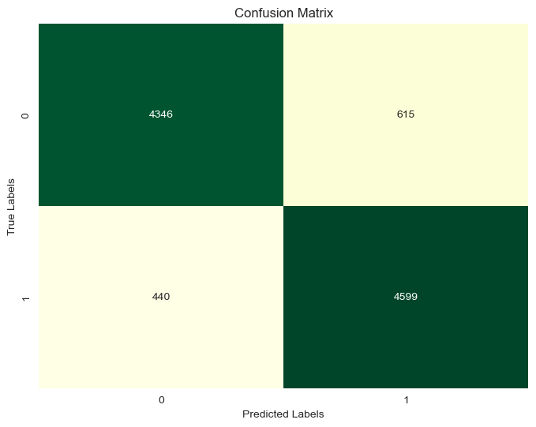
Result
The results gave that accuracy is 89 %.

Slide 9
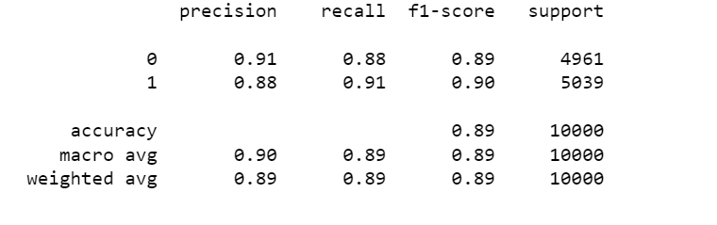
Classification report-logistic regression

Slide 10
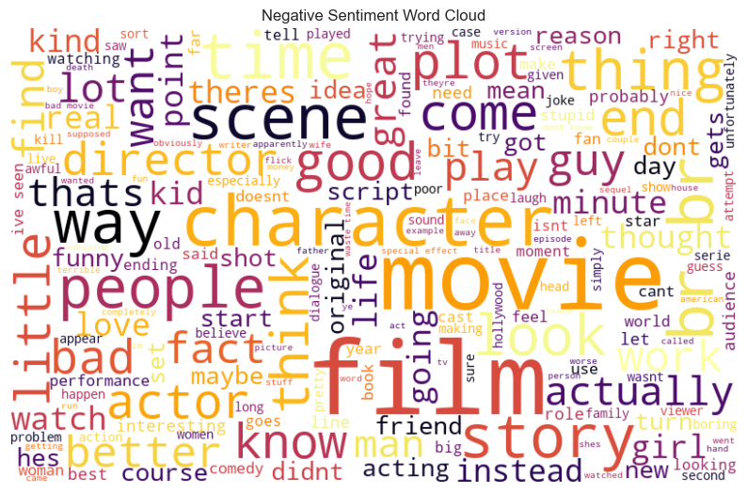
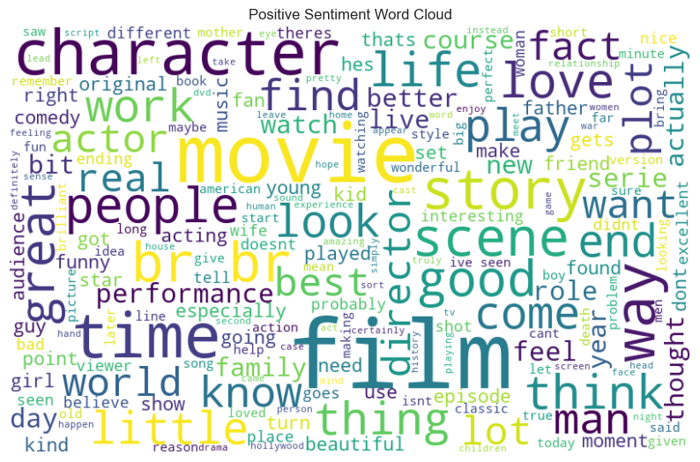
Data Visualisations made

Slide 11
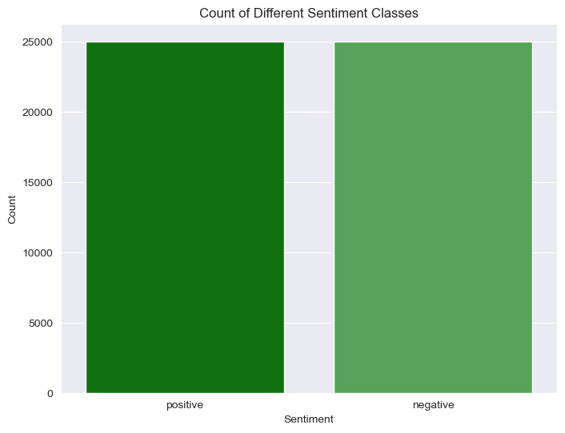
CLASS IMBALANCE – NO IMBALANCE

Slide 12
Conclusion
Findings and Effectiveness of the Proposed Solution:
The proposed solution for sentiment analysis on the IMDb dataset utilizing logistic regression achieved promising results with an accuracy of 89%. Through data preprocessing, feature engineering, and model training, the system effectively classified movie reviews into positive and negative sentiments, providing valuable insights into audience perceptions.
The effectiveness of the solution lies in its ability to accurately predict sentiment polarity, enabling stakeholders to gauge audience reactions towards movies. By understanding sentiments expressed in reviews, filmmakers, production houses, and streaming platforms can make informed decisions regarding content creation, marketing strategies, and audience engagement.
Challenges Encountered:
The primary challenge encountered during implementation was the handling of the large IMDb dataset, which posed computational and time constraints. Training machine learning models on sizable datasets can be resource-intensive, leading to longer processing times and potential scalability issues.

Slide 13
Future scope
Incorporate Additional Data:
User demographics: Include age, gender, location, and preferences for deeper insights.
Critic reviews: Aggregate sentiments from professional critics for a comprehensive view.
Optimize Algorithm:
Advanced NLP techniques: Explore transformer architectures and neural networks for better accuracy.
Ensemble learning: Combine predictions from diverse models for improved performance.
Expand Coverage:
Regional sentiment analysis: Adapt model for regional variations in language and culture.
Multi-lingual support: Extend system to analyze sentiments in multiple languages.
Integrate Emerging Technologies:
Edge computing: Enable real-time analysis by processing data on local devices or servers.
Federated learning: Collaboratively train models across distributed data sources while preserving privacy.
Enhance Visualization and Interpretability:
Interactive tools: Develop visualizations for exploring sentiment trends and influential factors.
Explanation for predictions: Provide insights into model decisions to increase transparency and trust.

Slide 14
References
Islam, Mohammad Mohaiminul, and Naznin Sultana. "Comparative study on machine learning algorithms for sentiment classification." International Journal of Computer Applications 182.21 (2018): 1-7.
Tripathi, Sandesh, et al. "Analyzing sentiment using IMDb dataset." 2020 12th International Conference on Computational Intelligence and Communication Networks (CICN). IEEE, 2020.
Ramadhan, Nur Ghaniaviyanto, and Teguh Ikhlas Ramadhan. "Analysis sentiment based on IMDB aspects from movie reviews using SVM." Sinkron: jurnal dan penelitian teknik informatika 7.1 (2022): 39-45.
Medhat, Walaa, Ahmed Hassan, and Hoda Korashy. "Sentiment analysis algorithms and applications: A survey." Ain Shams engineering journal 5.4 (2014): 1093-1113.
McKinney, Wes. Python for data analysis: Data wrangling with Pandas, NumPy, and IPython. " O'Reilly Media, Inc.", 2012.

Slide 15
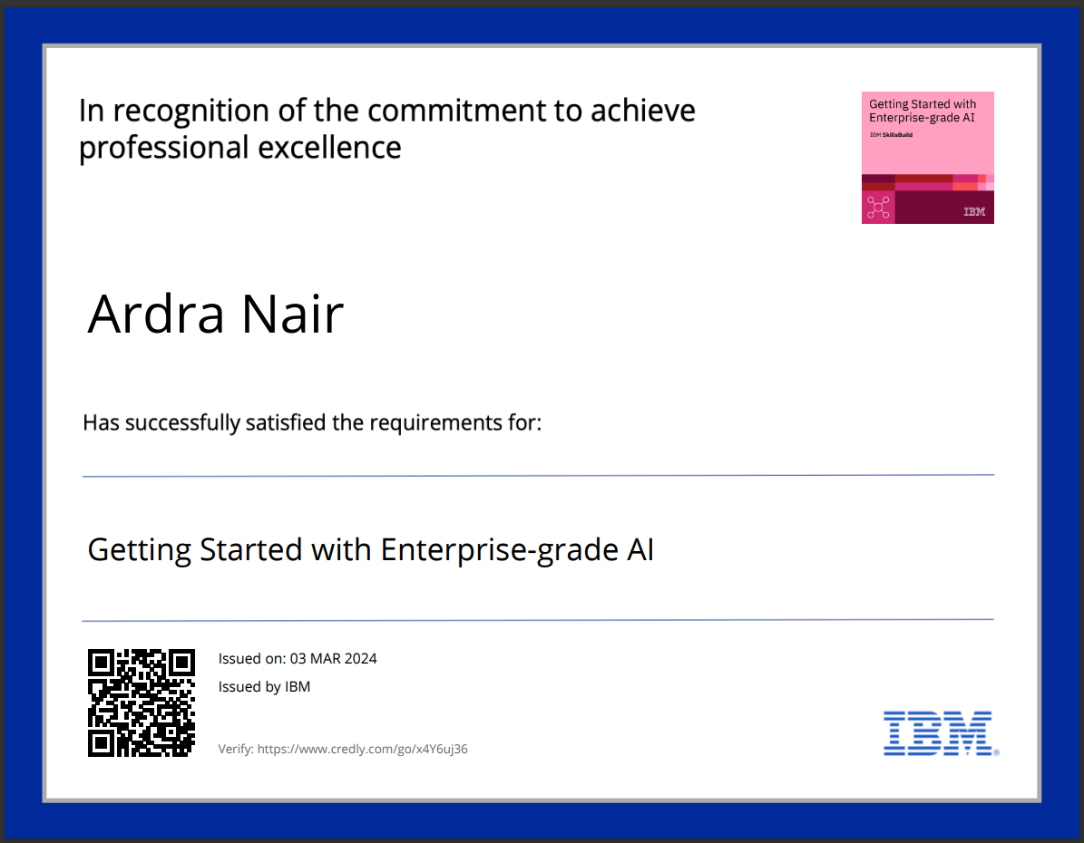
course certificate 1

Slide 16
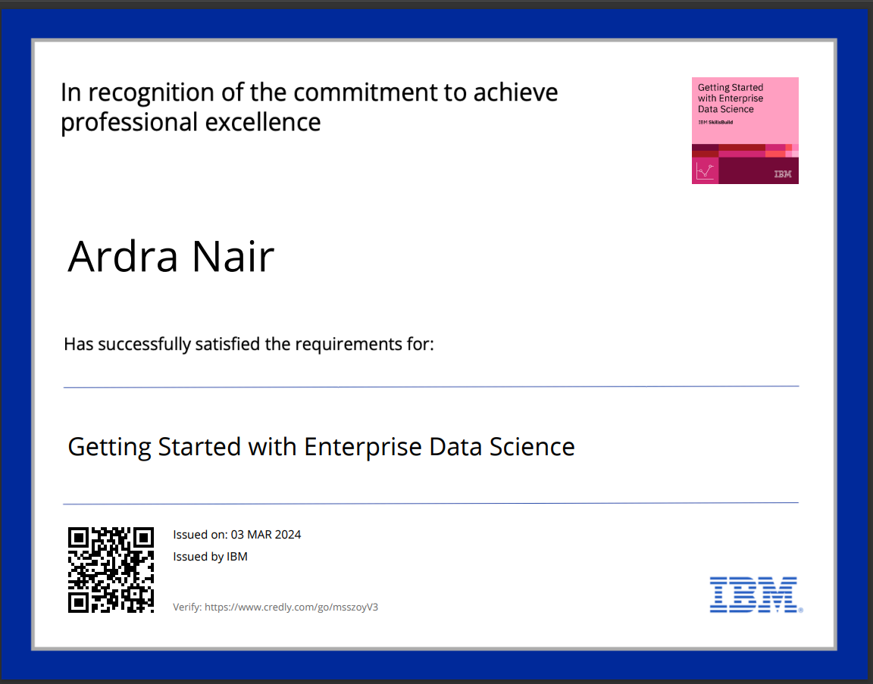
course certificate 2

Slide 17
THANK YOU

